Slide 3
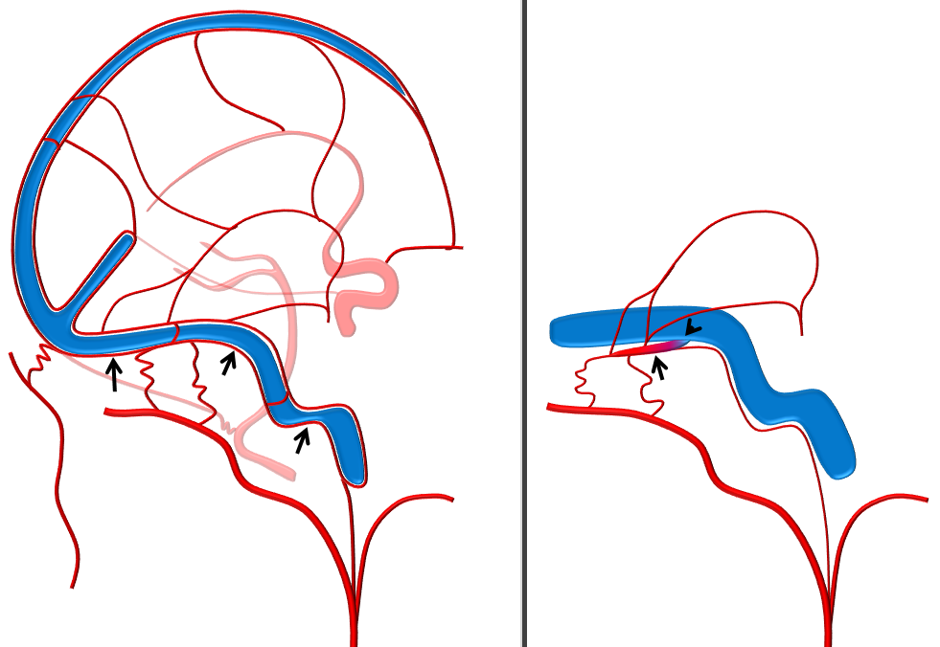
© neuroangio.org
© neuroangio.org

Slide 4
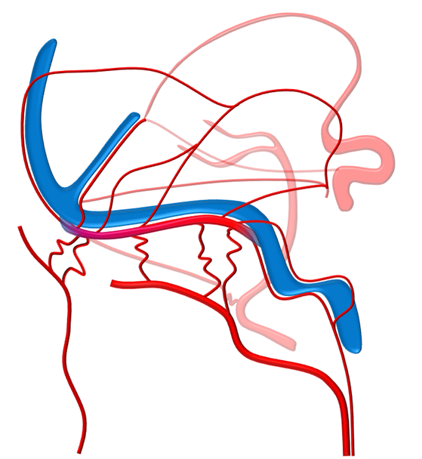
© neuroangio.org

Slide 5
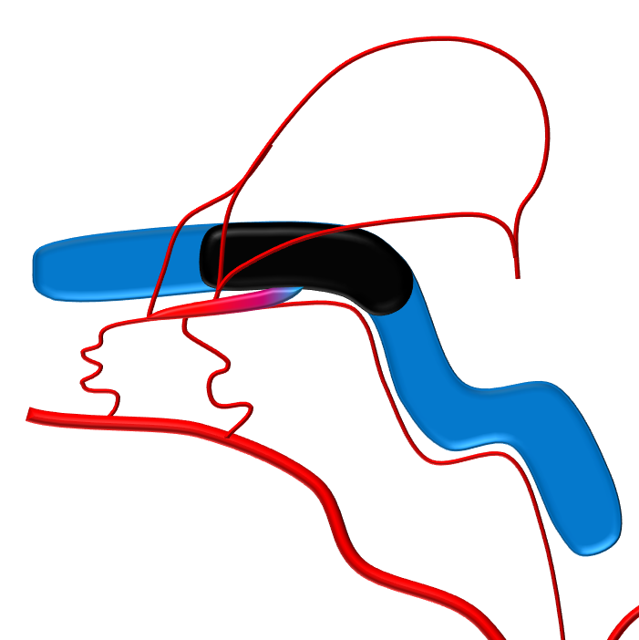
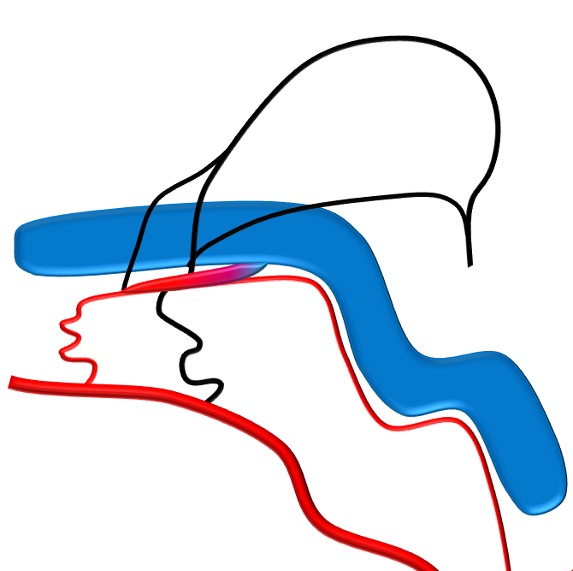
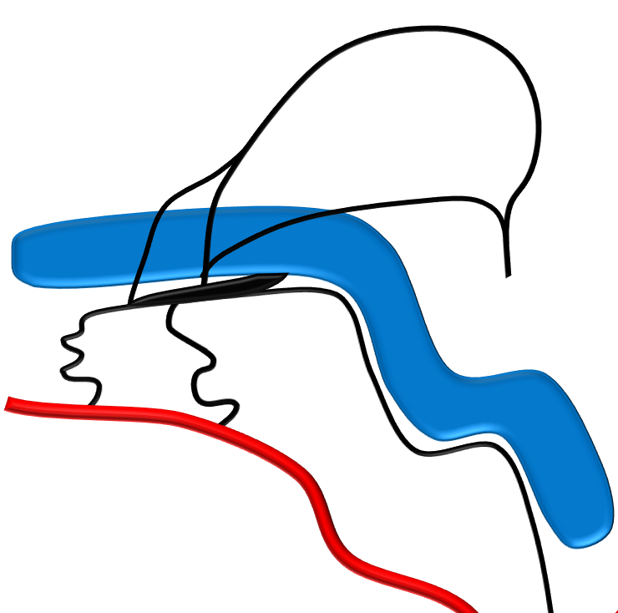
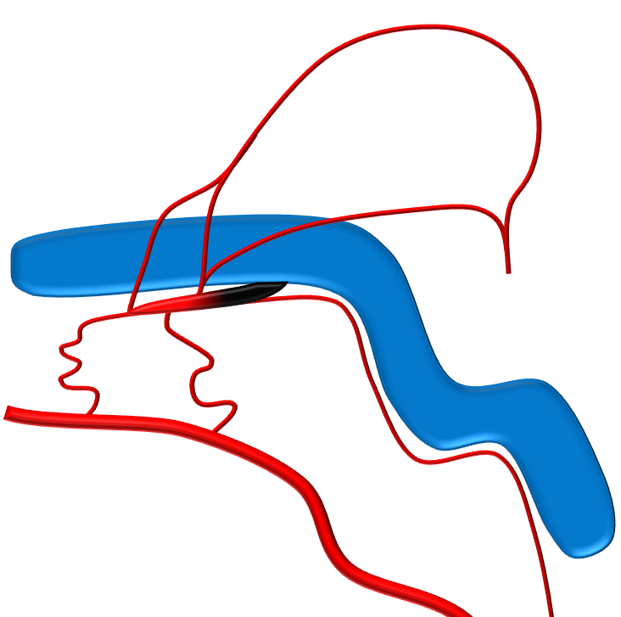
© neuroangio.org
© neuroangio.org
Transarterial Incomplete
Transvenous Unselective
Magic Bullet
© neuroangio.org
© neuroangio.org
Transarterial Complete
Transvenous Superselective
Notes:
Figure 2 (A-D). Schematic of typical transvenous sinus sacrifice (A), incomplete (B), and complete (C) transarterial embolizations, each of which results in an unnecessary closure of arteries or sinus. Targeted occlusion of the shunt (D) at the entrance of the collector channel into the sinus preserves both sinus and normal arterial structures.

